Slide 1
Predicting the target locations to open a Chinese Restaurant in Pune, India
By Sachin Jain

Slide 2
Benefits of identifying target locations
By analysing the neighbourhoods one can identify
The number of restaurants in the vicinity
The number of restaurants offering similar cuisines in the vicinity
The distance from the city centre.
It gives an brief overview of the neighbourhood and competition for the business
This becomes a good starting point for the individual to start his search for a good location

Slide 3
Data Acquisition and Cleaning
Get the details of the city centre and neighbouring boroughs
Identifying the restaurants in these areas
Filtering out the specific category of restaurants in this case Chinese restaurants
Identifying the areas with less restaurant density and no or very less Chinese restaurants

Slide 4
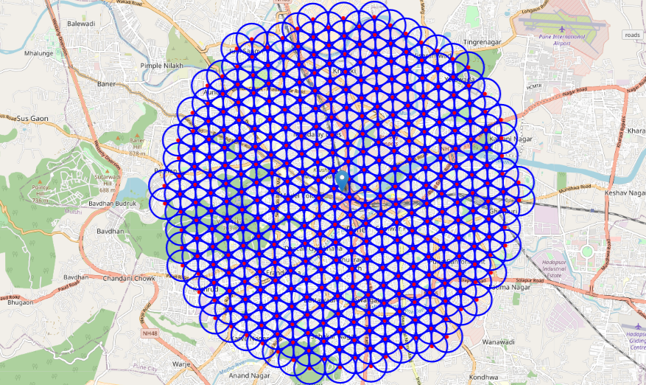
Identify City centre and surroundings

Slide 5
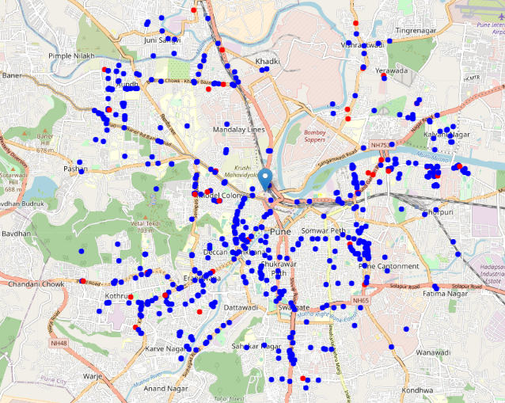
Locating the restaurants around CITY Centre

Slide 6
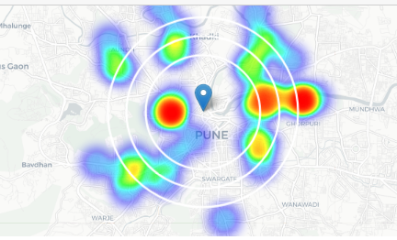
Identifying Density of Chinese restaurants around CITY Centre

Slide 7
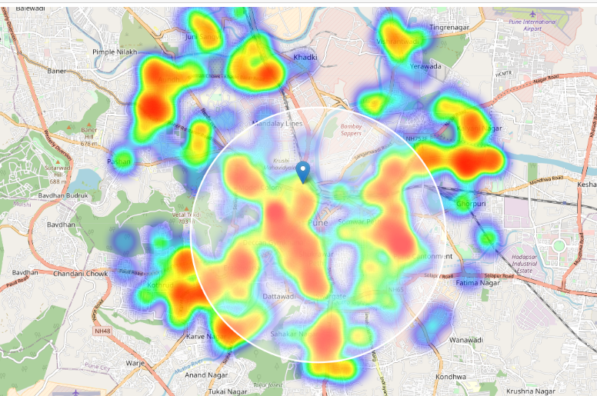
Finding area of focus

Slide 8
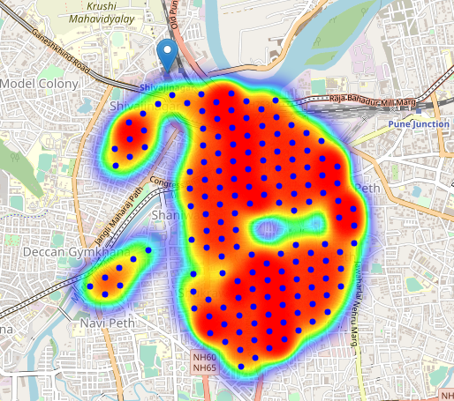
Narrowing the results

Slide 9
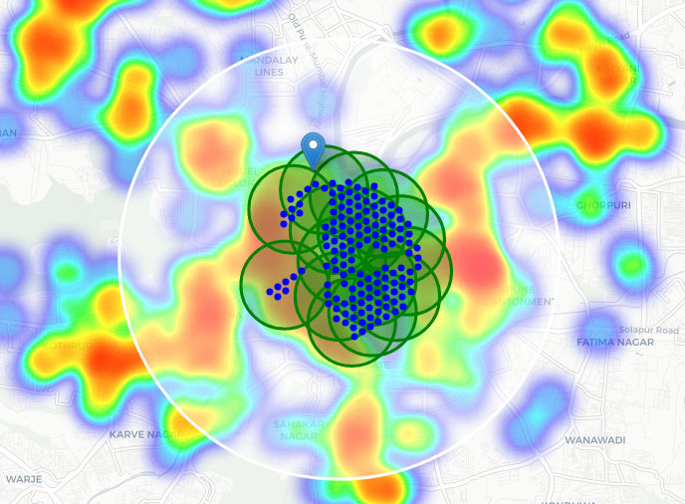
Finding area Clusters using K-means

Slide 10
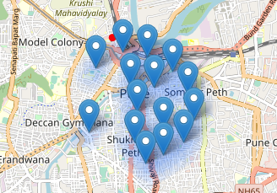
Shortlisting the 15 favourable cluster centres as locations where restaurant can be set up

Slide 11
Conclusion
By calculating restaurant density distribution from Foursquare data we have first identified general boroughs that justify further analysis (Swargate)
Then generated extensive collection of locations which satisfy some basic requirements regarding existing nearby restaurants.
Clustering of those locations was then performed in order to create major zones of interest (containing greatest number of potential locations) and addresses of those zone centres were created to be used as starting points for final exploration by stakeholders.

